Slide 1
ADWENTUREWORKS SALES
PRESENTED TO THE EXECUTIVE TEAM

Slide 2
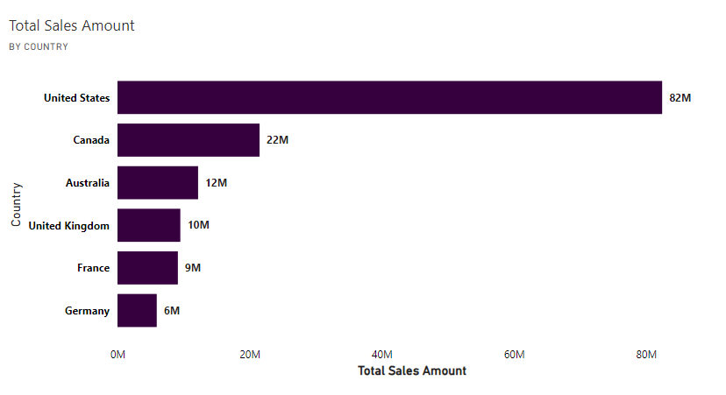
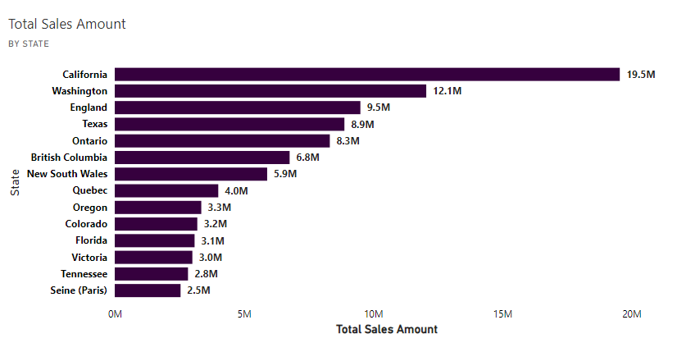
US accounts for majority of our Sales. California (19.5M) has sales almost worth the entirety of Canadian sales (22M)

Slide 3
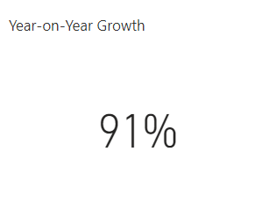
Year-on-year growth stands at 91%, indicating an impressive performance that should be maintained and built upon.

Slide 4
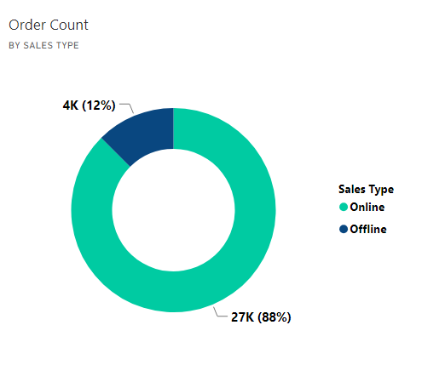
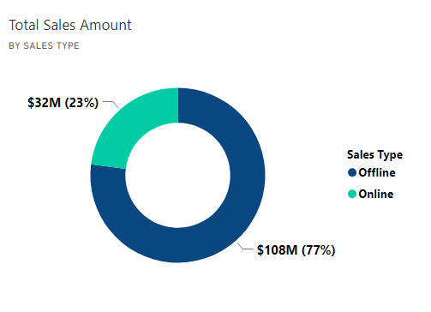
Although 88% of our orders came through Online channels, it generated just 23% of our revenue. 77% of our sales revenue was made through Offline channels.

Slide 5
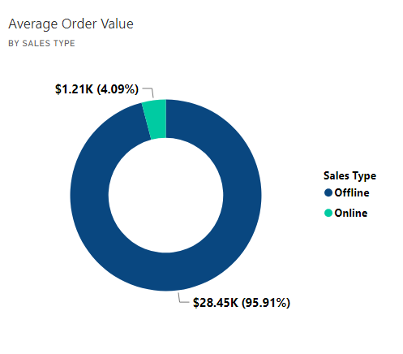
The average order value of Offline sales is over 20 times more than Online sales. indicating low revenue from online sales.

Slide 6
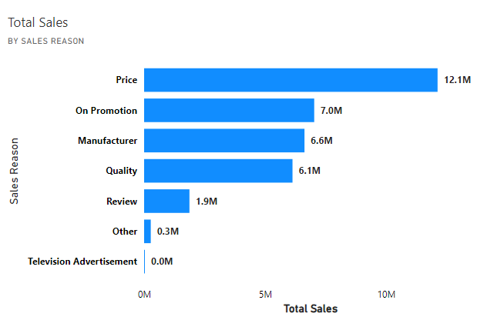
Our customers patronize our products online majorly because of Pricing and Promotional offers.

Slide 7
Summary of Findings
Online channels generate a high number of orders but low revenue.
The few orders we get offline generate the most revenue – 77%.
Prices and Promotional offers are biggest reasons for online sales
Year-on-Year Growth stands tall at 91%.

Slide 8
Recommendations
Fair pricing should be maintained and more promotional offers should be provided to generate more online sales.
Online sales should be looked into to discover why customers do not buy in large sums through the channel.
Growth drivers such as Offline sales type, Prices and Quality of products should be maintained.
Strategies to understand customer behavior offline should be adopted.

